Slide 1

Salus & SuperNeurons
GPU (Memory) Management
For Deep Learning
EECS 598 W20
2020-04-01 By Peifeng Yu

Slide 2
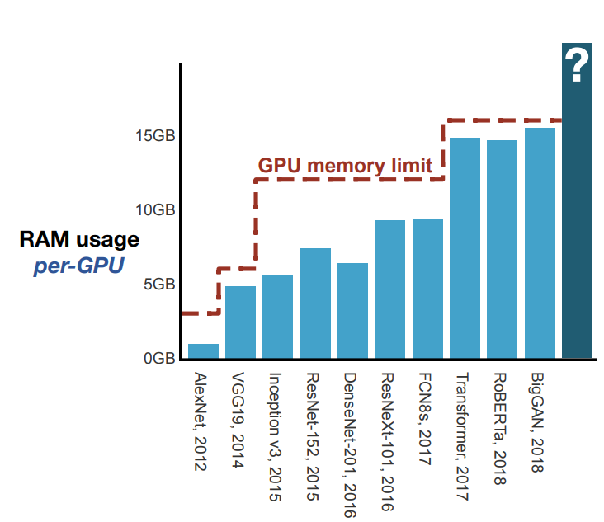
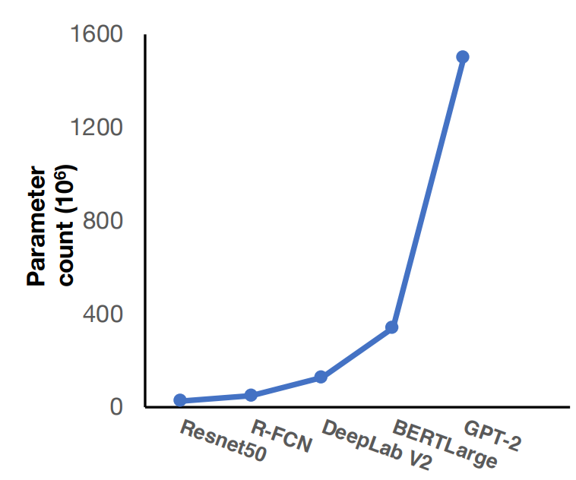
Deep Learning Memory Usage
Rapid growth in model size
State-of-the-art models quickly approach GPU memory capacity
Figures: J. Paras et al. “Checkmate: Breaking the Memory Wall with Optimal Tensor Rematerialization”. In: MLSys. 2020.
Notes:
- Familiar with DL

Slide 3
Topics Today
Salus: Fine-grained GPU Sharing Primitives for Deep Learning Applications
Goal: enable GPU sharing to improve utilization and flexibility
Iteration-level scheduling & GPU lane
SuperNeurons: Dynamic GPU Memory Management for Training Deep Neural Networks
Goal: minimize peak training memory requirement
Layer-wise liveness analysis & unified tensor pool & dynamic recomputation
Notes:
- Familiar with DL

Slide 4
Exclusive Access to GPU
An application can have multiple GPUs, but each GPU usually belongs to exactly one application at a time.
Advantages
Simplifies hardware design
Efficiency
Disadvantages
Lack of flexibility

Slide 5
Exclusive Access: Lack of Flexibility
Hinders the scheduling ability of GPU cluster managers
Underutilization
Hyper-parameter tuning (AutoML)
Model serving (inference)

Slide 6
Exclusive Access: Lack of Flexibility
Hinders the scheduling ability of GPU cluster managers
Starting or suspending job is expensive
Often easier to just do non-preemptive scheduling → FIFO
Head-of-line blocking

Slide 7
Exclusive Access: Lack of Flexibility
Underutilization
Variance in memory usage → Overprovision
Model | Peak Memory Usage
VAE | 28M
Super Resolution | 529M
Deep Speech | 3993M
Inception4 | 11355M

Slide 8
How Can We Efficiently Share a GPU for Deep Learning Applications?
Notes:
How can we break the exclusiveness and efficiently share a GPU?

Slide 9
GPU Sharing
Existing sharing solutions
Approach | Efficiency | Dynamic Memory | Flexible Scheduling
Static Partitioning (SP) | No | No | Yes
Multi-Process Service (MPS) | Yes | No | No
Approach | Efficiency | Dynamic Memory | Flexible Scheduling
Static Partitioning (SP) | No | No | Yes
Notes:
Gvim virtuGPU

Slide 10
Design Goals
Approach | Efficiency | Dynamic Memory | Flexible Scheduling
Approach | Efficiency | Dynamic Memory | Flexible Scheduling
Static Partitioning (SP) | No | No | Yes
Multi-Process Service (MPS) | Yes | No | No
Ideal | Yes | Yes | Yes
Approach | Efficiency | Dynamic Memory | Flexible Scheduling
Static Partitioning (SP) | No | No | Yes
Multi-Process Service (MPS) | Yes | No | No
Minimize deployment overhead
No new hardware
No modification from user side

Slide 11
Salus
Fine-grained GPU Sharing Primitives
for Deep Learning
A consolidated execution service enabling sharing primitives
Fast job switching,
Memory sharing
without modifying any
User scripts,
Operating systems, or
Hardware
with the goal to
Support new scheduler for GPU,
Improve GPU utilization

Slide 12
Salus in DL Stack
Salus
User scripts
Deep Learning Frameworks
Tensorflow
PyTorch
CNTK
Others
Salus Adaptor
Deep Learning Frameworks
…
Salus Execution Service
Salus Execution Service
CPU
GPU
FPGA
ASIC
…

Slide 13
Salus
Components
Salus Adaptor
Salus Execution Service | Transfer computation graph
Salus Adaptor | Consolidates all GPU accesses
Salus Execution Service

Slide 14
Salus in One Slide
Salus
Create session
Send computation graph
For each iteration:
Send input
Check memory
Queue in scheduler
User Script
User Script
…
DL Framework
DL Framework
…
Salus Adaptor
Salus Adaptor
Session
Scheduler
Memory Manager
GPU

Slide 15
Sharing Primitives
Efficient job switching
Memory sharing: GPU lane abstraction
Memory sharing: GPU lane abstraction
Deep Learning Frameworks

Slide 16
Sharing Primitives: Efficient Job Switching
Existing Approaches | Time Scale
Stop and restart (checkpointing) | 10~100s
Generate snapshot^{[1]} | ~1s
Deep Learning Frameworks
Bottleneck: data (memory) transfer
[1]: W. Xiao et al. “Gandiva: Introspective Cluster Scheduling for Deep Learning”. In: OSDI. 2018.
Notes:
Paramount to implement time sharing and preemption
To make sense of this statement, let's take a sidestep and have a closer look at memory usage of dl jobs

Slide 17
Understand DL Job Memory
3 types of memory:
Model
Ephemeral
Framework-internal
Deep Learning Frameworks

Slide 18
Understand DL Job Memory
3 types of memory:
Model
Ephemeral
Framework-internal
Data transfer time is non-negligible
Can be over 2X of corresponding inference latency
Model memory << GPU memory capacity
Deep Learning Frameworks
Why not keep multiple jobs’ model in memory for fast switching?
Notes:
Just transfer the model data: still, the data transfer time is non-negligible

Slide 19
Sharing Primitives: Efficient Job Switching
Job switching is done by determine which job’s iteration to run next.
Minimal switching overhead
Flexible scheduling policies
A trade-off between maximum utilization and execution performance
Notes:
That’s how we implemented an efficient job switching mechanism.
It has pros…
The downside is… We can not break the iteration.

Slide 20
Sharing Primitives
Efficient job switching
Deep Learning Frameworks
Job 1
Memory
Job 2
Time

Slide 21
Sharing Primitives
Efficient job switching
Memory sharing: GPU lane
Deep Learning Frameworks
Lane 1
Job 1
Job 2
Memory
Job 3
Lane 0
Time

Slide 22
Sharing Primitives: Memory Sharing
Efficient job switching
Memory sharing: GPU lane
GPU lane
Deep Learning Frameworks
= Continuous physical memory + GPU stream
Time-slicing within lane, parallel across lanes
Dynamic re-partitioning (lane assignment)
Avoid in-lane fragmentation

Slide 23
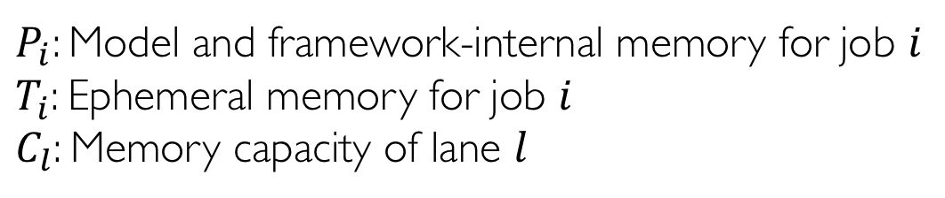
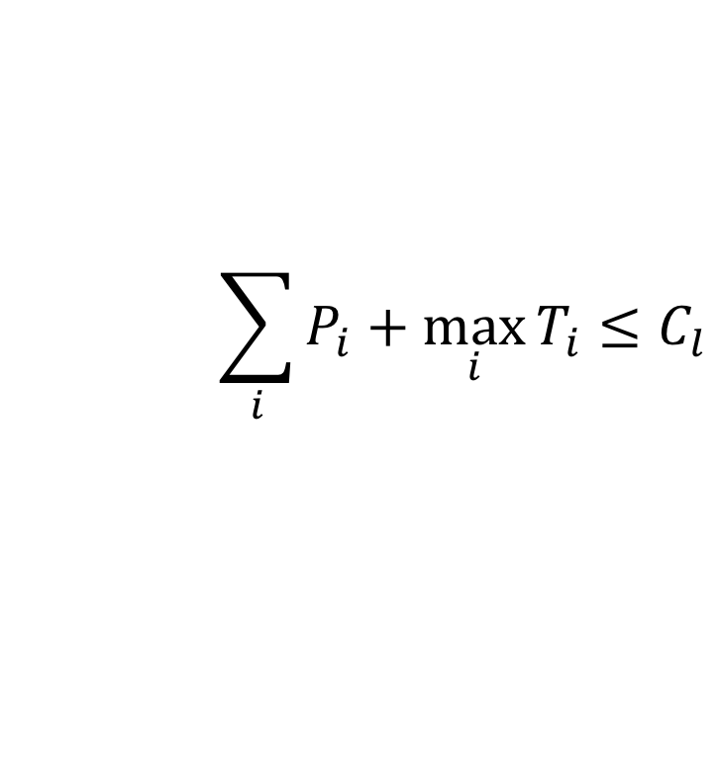
GPU Lane: Best Fit & Safety Condition
A lane cannot accept arbitrary number of jobs
The Safety Condition determines whether a job can go in a lane
$$\sum_{i}{P_{i}}+\max_{i}{T_{i}}≤C_{l}$$
$P_{i}$: Model and framework-internal memory for job $i$
$T_{i}$: Ephemeral memory for job $i$
$C_{l}$: Memory capacity of lane $l$

Slide 24
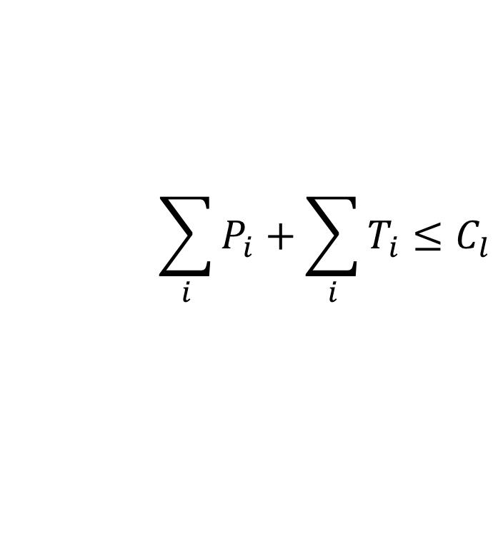
GPU Lane: Best Fit & Safety Condition
A lane cannot accept arbitrary number of jobs
The Safety Condition determines whether a job can go in a lane
$$\sum_{i}{P_{i}}+\sum_{i}{T_{i}}≤C_{l}$$
Static Partitioning:
$P_{i}$: Model and framework-internal memory for job $i$
$T_{i}$: Ephemeral memory for job $i$
$C_{l}$: Memory capacity of lane $l$

Slide 25
Salus Scheduling Polices
FIFO is suboptimal
HOL blocking
Underutilization
With Salus
Packing: achieves higher utilization
Preemption: enables prioritization
Fairness: equalizes the resource usage
…
What’s more?
Still a huge design space!

Slide 26
Evaluation
Deployment and evaluation on Intel E5-2670 with 2x NVIDIA Tesla P100 with 15 workloads
Flexible scheduler
Faster hyper-parameter tuning
High GPU utilization for inference

Slide 27
A Production Trace
100 jobs from a production trace^{[1]}
4 schedulers implemented as demo
SRTF vs FIFO: 3.19x improvement in Avg. JCT
[1]: G. Juncheng et al. “Tiresias: A GPU Cluster Manager for Distributed Deep Learning”. In: NSDI. 2019.
Notes:
TODO: CDF of 100 job trace

Slide 28
Sub-second Level Switching
Slice of the 100 job trace, time is normalized
Sub-second switching
Notes:
TODO: CDF of 100 job trace

Slide 29
Hyper-parameter Exploration
2 sets of hyper-parameter exploration
300 exploration jobs in each set
Makespan is important

Slide 30
Pack Inference Applications
42 DL inference applications in 1 GPU
User facing services: latency

Slide 31
Discussions
At the driver/infrastructure service layer, what is the desired outcome for Multi-GPU settings? What about distributed environments?
M:N job to GPU mapping
K GPUs per host & multiple hosts
Salus requires a profiling step to get memory usage info. Is there any better ways?
Given Salus becomes a common execution engine, what other opportunities does it enable?
Co-optimization of computation graph?

Slide 32
Topics Today
Salus: Fine-grained GPU Sharing Primitives for Deep Learning Applications
Goal: enable GPU sharing to improve utilization and flexibility
Iteration-level scheduling & GPU lane
SuperNeurons: Dynamic GPU Memory Management for Training Deep Neural Networks
Goal: minimize peak training memory requirement
Layer-wise liveness analysis & unified tensor pool & dynamic recomputation
Slides adapted from original PPoPP18 talk
Notes:
- Familiar with DL

Slide 33
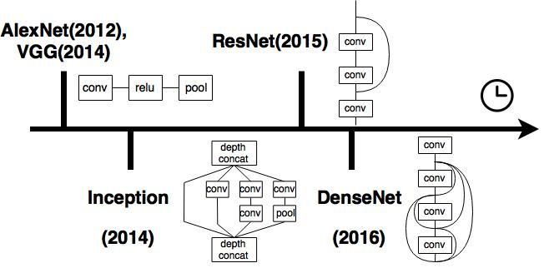
Architecture Evolution
Notes:
AlexNet has 9 sequential layers.
VGG also has a similar structure, consisting of 19 sequential layers.
Inception: less than 25 layers
ResNet is the first architecture that reaches 100 layers
DenseNet uses a full join to further improve the computation efficiency of ResNet.

Slide 34
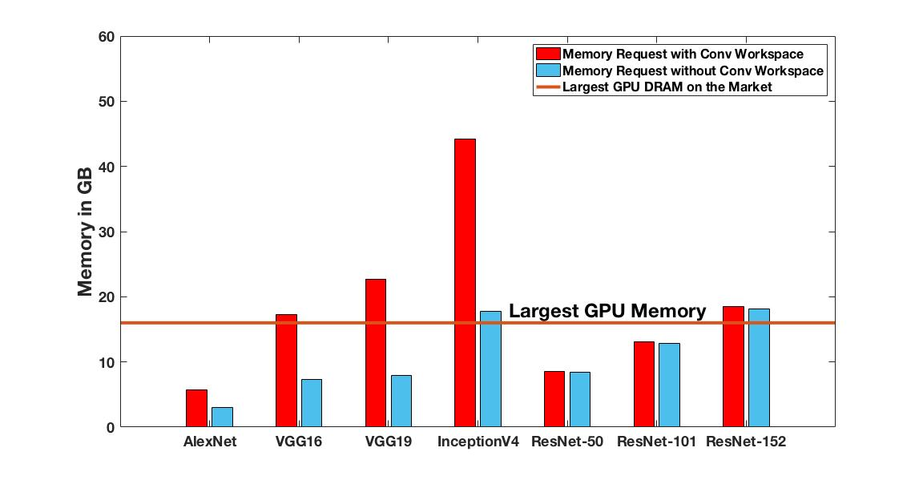
GPU Memory Shortage
Even for batch of 32
Notes:
In this plot,
the red bar is the training memory demand with convolution workspace,
while the blue one is the memory demand without the convolution workspace.
Convolution workspace is used to speedup the convolution, thereby it is critical to the overall performance.
As of today, the largest onboard GPU RAM is only 16 GB,
but it is far from sufficient from satisfy the training, even using batch of 32.

Slide 35




Review Existing Frameworks
No Liveness Analysis, Limited Support in
Non-linear Networks
Memory Offloading
Trade
Computations
for Memory
The Largest Trainable Network
Is NOT Bounded by the Layer
Consuming the Most Memory
Notes:
Let’s take a look at how existing frameworks handle the memory shortage issue.
Caffe and Torch direct reuse the forward tensors in the backward computation, but this scheme is limited in the non-linear cases.
With a full support of data flow analysis, later developed TensorFlow and MXNet perform much better in the tensor reusing.
They also introduce other memory saving techniques.
TensorFlow offloads some memory to the CPU, but it fails to optimize the communication between CPU and GPU.
We propose an abstraction of Unified Tensor Pool (UTP) to address this issue.
MXNet trades computations for memory, but the strategy raises the peak memory for neglecting the none-uniform memory distribution. We propose Cost-aware re-computations to resolve this issue.
Most importantly, none of these frameworks achieve the best scenario in computing at the layer-wise granularity.
That is, a network should be trainable as long as the layer with the most memory usage can fit into the GPU.

Slide 36
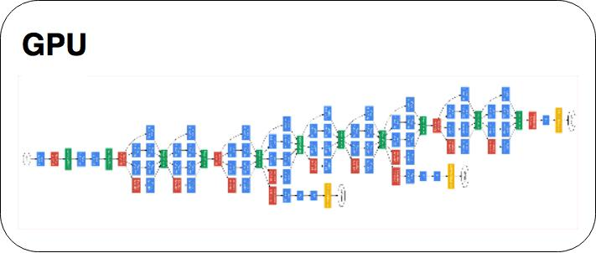
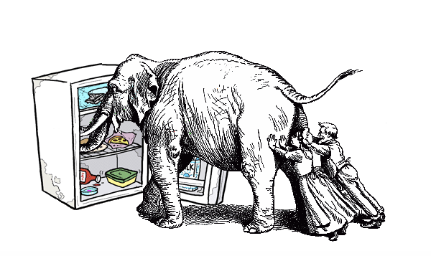

Goal
Largest GPU DRAM
Training Memory Request
16 GB
1000 GB
how?
Notes:
So, we want to achieve this best case. Apart from that, we also want to maintain a high training speed.

Slide 37
Outline of Techniques
Liveness Analysis
Unified Tensor Pool
Cost-aware Re-computation
Notes:
These three techniques jointly work together,
successfully reduce the network-wide peak memory usage ,
down to the maximal memory usage among layers.

Slide 38
Computation Patterns
LINEAR
None-LINEAR
AlexNet, VGG16 and VGG19
ResNet, Inception and DenseNet
join
fan
Static Dependency
Predictable
Dynamic Dependency
Unpredictable
Notes:
let’s analyze the data flow of linear and non-linear networks first.
In the linear networks, data is sequentially propagated in the forward pass;
and a layer’s backward computation simply depends on the previous layer.
Their computation and dependency patterns are static
regardless of the total layers involved,
and the dependency is predictable
even without pre-specifing the network architecture.
The dependencies are much more complicated in the non-linear cases.
We generalize two types of non-linear connections.
The first is join connections, which is used in ResNet and DenseNet.
It forwards the output of a layer to sevearl layers ahead.
The second is the fan connection, which is used in Inception Unit.
It spans multiple branches and merges them together.
In general, the data dependency is unpredictable
without pre-specifying the network architecture.

Slide 39
Opportunity 1: Reusing at Different Time
Core Idea:
reuse the same physical memory at different time partitions
Liveness Analysis
Notes:
We found the first memory saving opportunity in the data flow.
The core observation here is
“ Not all the tensors are in use at the same time”.
For example, in the top left figure, the tensors in red
are no longer needed when back-propagated to POOL layer.
This is also true for the non-linear architecture on the right.
This implies we can reuse the same physical memory
at different time partitions, (CLICK)
and this motivates us applying Liveness Analysis in the training.

Slide 40
Liveness Analysis: 50% Memory Saving
Step 1
t0
t0
CONV
CONV
POOL
FC
S
t0
CONV
CONV
POOL
FC
S
Live Tensor
Freed Tensor
t0,
Notes:
Here is an animation about how “liveness analysis” works.
In general, we will check the dependency of subsequent computation steps.
If a tensor will be needed, we keep the tensor “live”, and free them otherwise.
Let’s start with the forward propagation.

Slide 41
Liveness Analysis: 50% Memory Saving
Step 2
t0
t0
t1
CONV
CONV
POOL
FC
S
t0
t1
CONV
CONV
POOL
FC
S
Live Tensor
Freed Tensor
t0, t1,
Notes:
Here we keep the output for the backward pass.

Slide 42
Liveness Analysis: 50% Memory Saving
Step 3
t0
t0
t1
t2
CONV
CONV
POOL
FC
S
t0
t1
t2
CONV
CONV
POOL
FC
S
Live Tensor
Freed Tensor
t0, t1, t2,

Slide 43
Liveness Analysis: 50% Memory Saving
Step 4
t0
t0
t1
t2
t3
CONV
CONV
POOL
FC
S
t0
t1
t2
CONV
CONV
POOL
FC
S
Live Tensor
Freed Tensor
t0, t1, t2, t3,

Slide 44
Liveness Analysis: 50% Memory Saving
Step 5
t0
t0
t1
t2
t3
CONV
CONV
POOL
FC
S
t0
t1
t2
t4
CONV
CONV
POOL
FC
S
Live Tensor
Freed Tensor
t0, t1, t2, t4,
t3,
Notes:
We start to free the first tensor here, as T3 is no longer needed in the subsequent computations.

Slide 45
Liveness Analysis: 50% Memory Saving
Step 6
t0
t0
t1
t2
t3
CONV
CONV
POOL
FC
S
t0
t1
t2
t4
CONV
CONV
POOL
FC
S
t5
Live Tensor
Freed Tensor
t0, t1, t2, t5,
t3, t4,

Slide 46
Liveness Analysis: 50% Memory Saving
Step 6
t0
t0
t1
t2
t3
CONV
CONV
POOL
FC
S
t0
t1
t2
t4
CONV
CONV
POOL
FC
S
t5
Live Tensor
Freed Tensor
t0, t1, t2, t5,
t3, t4,

Slide 47
Liveness Analysis: 50% Memory Saving
Step 7
t0
t0
t1
t2
t3
CONV
CONV
POOL
FC
S
t0
t1
t2
t4
t6
CONV
CONV
POOL
FC
S
t5
t6
Live Tensor
Freed Tensor
t0, t1, t6,
t2, t3, t4, t5,

Slide 48
Liveness Analysis: 50% Memory Saving
Step 8
t0
t0
t1
t2
t3
CONV
CONV
POOL
FC
S
t0
t1
t2
t4
t7
t6
CONV
CONV
POOL
FC
S
t5
t6
Live Tensor
Freed Tensor
t0, t6, t7,
t1, t2, t3, t4, t5,

Slide 49
Liveness Analysis: 50% Memory Saving
Step 9
t0
t0
t1
t2
t3
CONV
CONV
POOL
FC
S
t0
t1
t2
t4
t8
t7
t6
CONV
CONV
POOL
FC
S
t5
t6
Live Tensor
Freed Tensor
t6, t8,
t0, t1, t2, t3, t4, t5, t7,

Slide 50
Liveness Analysis: 50% Memory Saving
Step 10
t0
t0
t1
t2
t3
CONV
CONV
POOL
FC
S
t0
t1
t2
t4
t8
t7
t6
CONV
CONV
POOL
FC
S
t5
t6
Live Tensor
Freed Tensor
t0, t1, t2, t3, t4, t5, t6, t7, t8

Slide 51
Liveness Analysis: 50% Memory Saving
Step 5
t0
t0
t1
t2
t3
CONV
CONV
POOL
FC
S
t0
t1
t2
t4
CONV
CONV
POOL
FC
S
Liveness Analysis Maximum
Baseline Maximum
t0, t1, t2, t4,
t0, t1, t2, t3, t4, t5, t6, t7, t8
4 Tensors
9 Tensors
Notes:
Let’s use the baseline of keeping all the tensors in the GPU.
We compare the effect of liveness analysis against the baseline.
With liveness analysis, we reach the maximal memory at Step 5 with 4 live tensors,
while the baseline uses 9 tensors.
This demonstrates over half memory reduction.
In general, we start freeing tensors in the backward,
therefore liveness analysis offers round 50% memory saving.

Slide 52
Liveness Analysis on AlexNet
Notes:
AlexNet has 23 forward steps and 23 backward steps;
The forward and backward steps are splitted by the black vertical line in the middle.
After applying the liveness analysis,
the blue line represents the actual memory usage at individual steps,
while the orange line represents the live tensor counts.
We see live tensor counts keep increasing in the forward,
and start decreasing in the backward.
With liveness analysis, the peak memory gets reduced by almost 800 MB from the baseline.

Slide 53
Liveness Analysis Performance Issue
Problem: frequent memory operations
Solution: pre-allocated memory pool

Slide 54
Opportunity 2: Using External Buffer
Notes:
We observe the second memory saving opportunity in the computation patterns. (CLICK) (CLICK)
The top figure is the percentage of computation, while the bottom figure is the memory usage.
As highlighted in the figure, Convolution dominates most of the time,
suggesting the opportunity to overlap communications with computations.
This motivates us to use an external memory pool for offloading.

Slide 55
Unified Tensor Pool (UTP)
Offload
Pre-fetch
Offload happens right after computation
Pre-fetch distance: num of layers to fetch ahead
Move outputs of CONV layers to CPU DRAM
Retrieve outputs of CONV layers back to GPU
Notes:
So, the second memory reduction technique proposed by us is “Offload and Pre-fetch”.
Offload is to move outputs of CONV layers to CPU DRAM,
while Pre-fetch is to retrieve the offloaded outputs back to GPU.
In our implementation, we use the relatively large CPU DRAM as a the external buffer for tensor offloading.
But the concept is extensible to a broad physical memory. (CLICK)
We propose an Unified Tensor Pool Abstraction or UTP to integrate various physical memory.
The runtime allocates tensors, and each tensor requests memory from the UTP.
UTP manages the actual memory locations, and it can be located at the local CPU DRAM, or other remote places such as other Network GPU DRAM.
Each remote allocations need communications to retrieve the actual content,
and the communication type depends on the location of remote memory.
For example, If the memory is at other network CPU DRAM, the communication can be RDMA.

Slide 56
Pre-fetch and offload on AlexNet

Slide 57
Problem of On-demand Offload & Prefetch
Problem: tensors are swapped out immediately after computation. This is not necessary given enough GPU memory
Solution: LRU cache in local GPU DRAM to reduce the data movement

Slide 58
Opportunity 3: Cost-aware Re-computation
Notes:
We also observe the third memory saving opportunity the computation pattern.
The time of non-convolution layers such as Activation and Batch Normalization are relatively small,
but the memory usages of these layers are not trivial.
These are highlighted by the red box in both figures.
So, it suggests an opportunity to reconstruct their results with little extra computations. (CLICK)
We introduce a new cost-aware re-computation strategy to
maintain a good performance
while the core idea of the re-computation for memory
is to re-construct the forward dependency from the nearby convolution layers.
Let’s first exam two basic re-computation strategy, Memory Centric and Speed Centric strategy.

Slide 59
Speed Centric vs Memory Centric
Memory centric: recompute every cheap layer as many times as needed
Pros: the least live tensors
Cons: the most re-computations: O(n^2)
Speed centric: recompute only once, remember the results
Pros: the least re-computations
Cons: the most live tensors
Cost-aware recomputations
A simple if-else case
If to-be-recomputed tensors memory usage > largest layer memory
Speed centric
Else
Memory centric

Slide 60
Cost-aware Recomputations on AlexNet

Slide 61
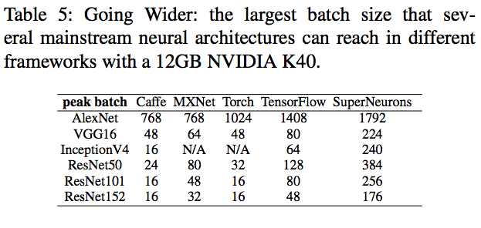
Overall Evaluations: Max Batch Size

Slide 62
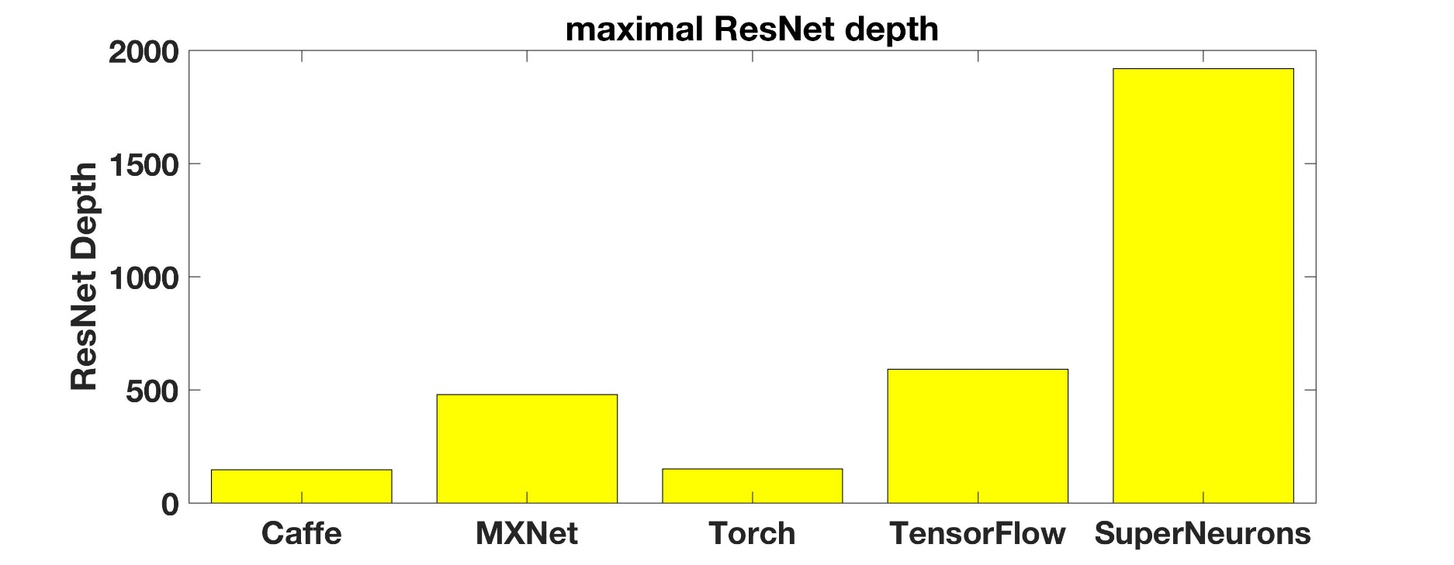
Overall Evaluations: Larger # of Layers
Note: depth = 3*(n1 + n2 + n3 + n4)+2. We fix n1 =6, n2 =32, and n4 =6, while adding n3 to increase the depth.

Slide 63
Overall Evaluations: Speed
AlexNet
ResNet101
Inception v4
VGG 16
Notes:
Here is an evaluation of speed among different frameworks.
Our runtime consistent delivery the leading speed even though we can handle a much bigger network.
There is a trend for the performance to decrease with the increasing batch size. This is because of the increasing communications,
and it is hard to perfectly overlap computations with communication especially on the non-linear networks.

Slide 64
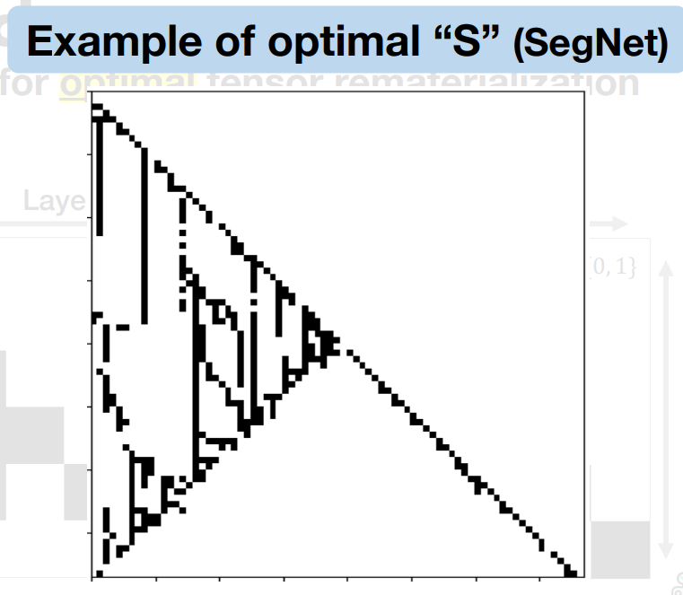
Discussions
Does the technique applies to other types of network layers?
Why is it necessary to decide the recomputation/swap at runtime given the DAG is fixed?
Checkmate: Breaking the Memory Wall with Optimal Tensor Rematerialization (MLSys20)

Slide 65
Overhead

Slide 66
Salus Enable Fast Switching in SRTF
2 slices of the 100 job trace
Time is normalized
Notes:
TODO: CDF of 100 job trace

Slide 67
Overhead

Slide 68
#1
Codebase Optimization
Minimize overhead
Stable interface for policies
#2
Multi-Device Support
Automatic device placement with DAG scheduling
Computation devices across RDMA network
Three
Followups
#3
Unified Internal Representation
For easier integration of frameworks & Salus
Notes:
General-purpose coflow scheduling raises many challenges, and at least four remain unanswered in this work.
First, how to handle dependencies between multiple stages of a data-parallel job and multiple waves of a data-parallel job.
Second, how to emulate smallest-first scheduling without knowing flow sizes or the number of flows.
Third, how to handle master failure and support low latency coflows?
Baraat addresses all three in the context of tasks, i.e., in the context of point-to-multipoint or multipoint-to-point coflows.
For data-parallel jobs, a more scenario is multipoint-to-multipoint scenario where matching plays an important role in addition to ordering.

Slide 69
Schedule at GPU Kernel Level?
Central kernel-based scheduler
Breaks common efficiency optimizations: kernel batching and pipelining
Ephemeral allocation is not atomic!

Slide 70
Schedule at GPU Kernel Level?
Central kernel-based scheduler
Breaks common efficiency optimizations: kernel batching and pipelining
Ephemeral allocation is not atomic!
12 GB
Job A/B: 1 GB persistent, 7 GB temporary
P_{B}+= 1 GB
T_{B}+= 2 GB
Job X allocates n GB model memory
T_{B}+= 2 GB
P_{X}+= n GB
T_{A}+= 3 GB
T_{B}+= 3 GB
Job X allocates n GB ephemeral memory
T_{A}+= 2 GB
T_{X}+= n GB
T_{A}+= 2 GB
0 GB
P_{A}+= 1 GB
Time

Slide 71
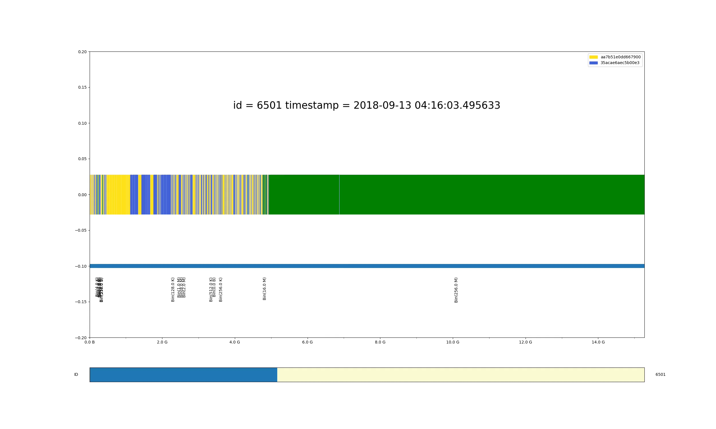
In-Lane Memory Fragmentation
In-lane Fragmentation

Slide 72
GPU Lane: Allocation
An event-driven algorithm: reacts when job arriving / finishing
If possible to create new lane -> create
If possible to reuse existing one -> reuse
If possible to defrag -> defrag
Otherwise, wait

Slide 73
Multi-GPU: the Rescue or Nightmare?
Data parallelism
Model parallelism
Parameter server? Communication?
Ad-hoc memory aggregation
Modify model to fit in the memory
→ Worse memory under-utilization
ML practitioners always have to deal with low-level hardware details. No clean separation of concerns.
Notes:
This is one of the major reaons for memory underutilization issue in cluster.
Most of time, more than 80% memory is allocated to applications.
However, the actually usage is lower than 50%.
Users/ Applications are requesting extra memory to protect their performance.
Large portion of memory is not utilized, although they are allocated.
How can we use this part memory?
To protect their performance. Their
Each machines are having different free memory
And the used memory are imbalanced across the cluster
High priority
Middle priority
Low priority
12k machines

Slide 74
They Don’t Even Care!
Expectation's from ML practitioners
Handle larger model and data
Mix & match networks and layers
Something smart and just runs
Improve application performance and cluster efficiency
Minimize deployment overhead
No new hardware
No software modification
Tolerate failures
Machine crash, network disconnection
Manage remote memory at scale
as efficient/convenient as possible
Average memory usage less than 50%
Peak-to-average ratio as high as 4.86x
GPU allocation: one or nothing
Notes:
This is one of the major reaons for memory underutilization issue in cluster.
Most of time, more than 80% memory is allocated to applications.
However, the actually usage is lower than 50%.
Users/ Applications are requesting extra memory to protect their performance.
Large portion of memory is not utilized, although they are allocated.
How can we use this part memory?
To protect their performance. Their
Each machines are having different free memory
And the used memory are imbalanced across the cluster
High priority
Middle priority
Low priority
12k machines

